Slide 1

Blockchain
Sunitha R
Department of Computer Science and Engineering

Slide 2

Blockchain
Consensus Algorithms: Byzantine Fault Tolerance System
Sunitha R
Department of Computer Science and Engineering

Slide 3





Blockchain
Consensus Algorithm – Byzantine Generals Problem
Paxos and Raft can tolerate up to N/2− 1 number of crash faults
What if the nodes behave maliciously?

Slide 4





Blockchain
Consensus Algorithm – Byzantine Generals Problem
Attack
Attack

Slide 5
Blockchain
Consensus Algorithm – Byzantine Generals Problem
Retreat
Retreat

Slide 6

Blockchain
Consensus Algorithm – Byzantine Generals Problem
Attack
Retreat

Slide 7
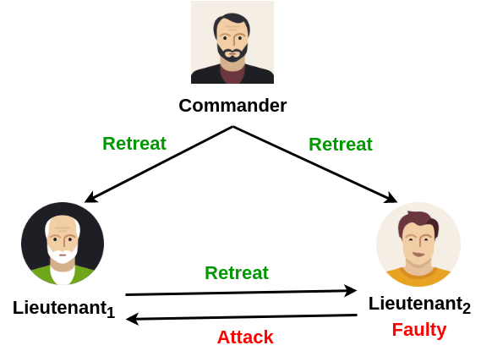
Blockchain
Three Byzantine Generals Problem: Lieutenant Faulty
Round1:
Commander correctly sends same message to Lieutenants
Round 2:
Lieutenant₁ correctly echoes to Lieutenant₂
Lieutenant₂ incorrectly
echoes to Lieutenant₁

Slide 8
Blockchain
Three Byzantine Generals Problem: Lieutenant Faulty
Lieutenant₁ received
differing message
By integrity condition, Lieutenant₁ bound to decide on Commander message
What if Commander is faulty?

Slide 9
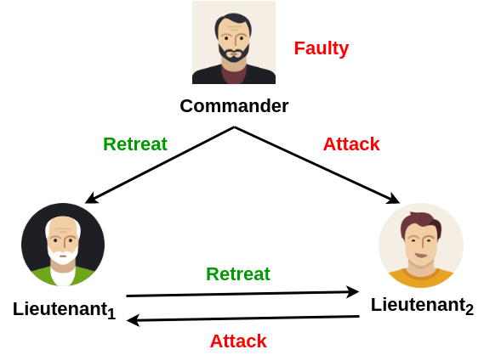
Blockchain
Three Byzantine Generals Problem: Commander Faulty
Round 1:
Commander sends differing message to Lieutenants
Round 2:
Lieutenant₁ correctly echoes to Lieutenant₂
Lieutenant₂ correctly echoes to Lieutenant₁

Slide 10
Blockchain
Three Byzantine Generals Problem: Commander Faulty
Lieutenant₁ received differing message
By integrity condition, both Lieutenants conclude with Commander’s message
This contradicts the agreement condition
No solution possible for three generals including one faulty

Slide 11
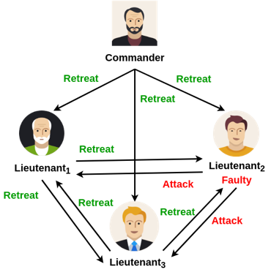
Blockchain
Four Byzantine Generals Problem: Lieutenant Faulty
Round 1:
Commander sends a message to each of the Lieutenants
Round 2:
Lieutenant₁ and Lieutenant₃ correctly echo the message to others
Lieutenant₂ incorrectly echoes to others

Slide 12
Blockchain
Four Byzantine Generals Problem: Lieutenant Faulty
Lieutenant₁ decides on majority(Retreat,Attack,Retreat)= Retreat
Lieutenant₃ decides on majority(Retreat,Retreat,Attack)= Retreat

Slide 13
Blockchain
Four Byzantine Generals Problem: Commander Faulty
Round 1:
Commander sends differing message to Lieutenants
Round 2:
Lieutenant₁, Lieutenant₂ and Lieutenant₃ correctly echo the message to others

Slide 14
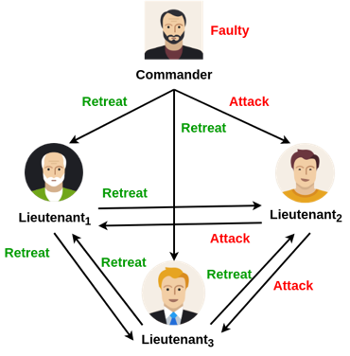
Blockchain
Four Byzantine Generals Problem: Commander Faulty
Lieutenant₁ decides on majority(Retreat,Attack,Retreat)= Retreat
Lieutenant₂ decides on majority(Attack,Retreat,Retreat)= Retreat
Lieutenant₃ decides on majority(Retreat,Retreat,Attack)= Retreat

Slide 15
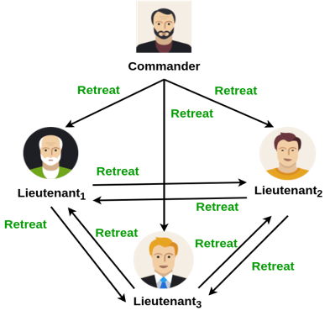
Blockchain
Byzantine Generals Model
N number of process with at most f
faulty
Receiver always knows the identity of the sender
Fully connected
Reliable communication medium
Synchronous system

Slide 16
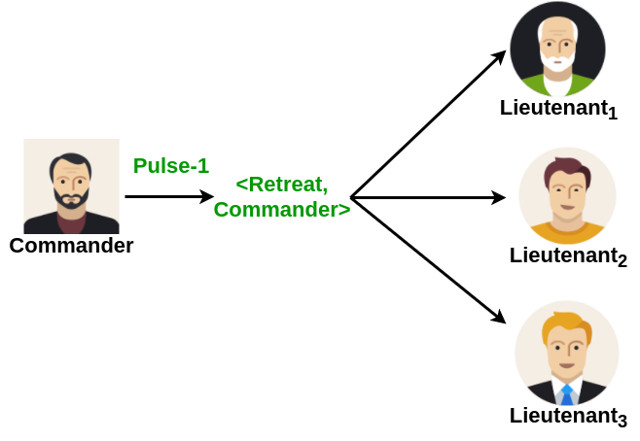
Blockchain
Lamport-Shostak-Pease Algorithm
Base Condition:
Broadcast(N,t=0)
N: number of processes
t: algorithm parameter
Commander decides on its own value
Courtesy: Lamport, Leslie, Robert Shostak, and Marshall Pease. "The Byzantine generals problem." ACM Transactions on Programming Languages and Systems (TOPLAS) 4.3 (1982): 382-401.

Slide 17
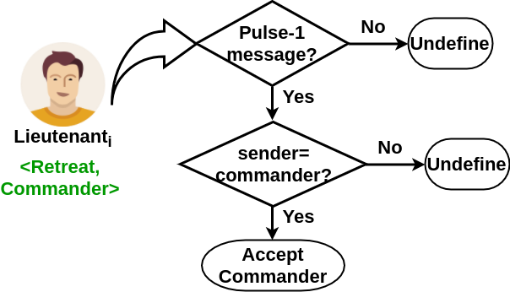
Blockchain
Lamport-Shostak-Pease Algorithm
Base Condition:
Broadcast(N,t=0)
N: number of processes
t: algorithm parameter
Lieutenants decision by sender matching

Slide 18
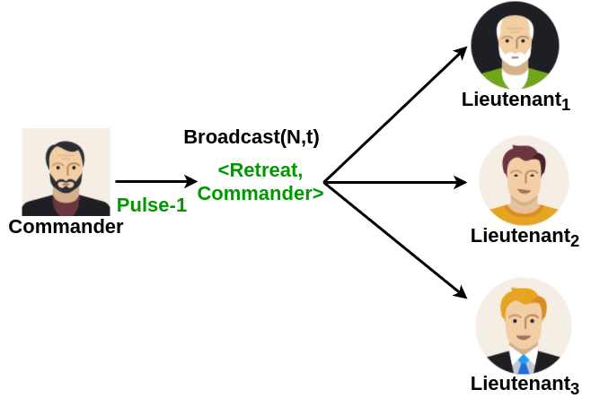
Blockchain
Lamport-Shostak-Pease Algorithm
General Condition:
Broadcast(N,t)
N: number of processes
t: algorithm parameter
Only commander sends to all lieutenants

Slide 19
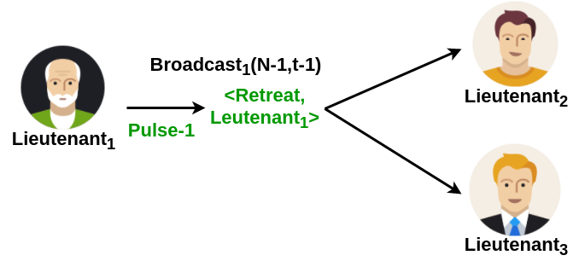
Blockchain
Lamport-Shostak-Pease Algorithm
General Condition:
Broadcast(N,t)
N: number of processes
t: algorithm parameter
All lieutenants broadcast their values to the other lieutenants except the senders

Slide 20
Blockchain
Supplementary Reading
Lamport, Leslie, Robert Shostak, and Marshall Pease. "The Byzantine generals problem." ACM Transactions on Programming Languages and Systems (TOPLAS) 4.3 (1982): 382-401.
https://www.youtube.com/watch?v=VWG9xcwjxUg
https://www.binance.vision/Blockchain/byzantine-fault-tolerance-explained

Slide 21
THANK YOU
Sunitha R
Department of Computer Science and Engineering
Sunithar@pes.edu

